Slide 1
Predictive Analytics on Diabetes
Pranshu Tiwari

Slide 2
Problem Statement
Need Predictor mark up for Diabetes, Pre-Diabetes given some of the well known biological variable like
  BMI
  Triceps Thickness
  Hereditary
  Diastolic Pressure
  Age

Slide 3
Rationale for Developing a model
Insurance Companies & Health companies needs a model to find high risk cases for Diabetes by looking at General health data for:
  Insurance Company
      High Premiums for True Positive Cases
      Low Premiums for True Negative Case
  Health Company
    Critical Diabetic Patients who wish to subscribe for strict health regimen to prevent Diabetes/ Pre Diabetes
Predicting Diabetic outcome in Pre-Diabetic Patients

Slide 4
Dataset on Pima Indian Diabetes has been used to build the model and do validation testing on the model
768 instances of Health Parameters include-
  1. Number of times pregnant
  2. Plasma glucose concentration a 2 hours in an oral
  glucose tolerance test
  3. Diastolic blood pressure (mm Hg)
  4. Triceps skin fold thickness (mm)
  5. 2-Hour serum insulin (mu U/ml)
  6. Body mass index (weight in kg/(height in m)^2)
  7. Diabetes pedigree function
  8. Age (years)

Slide 5
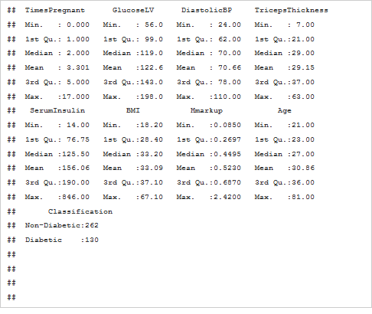
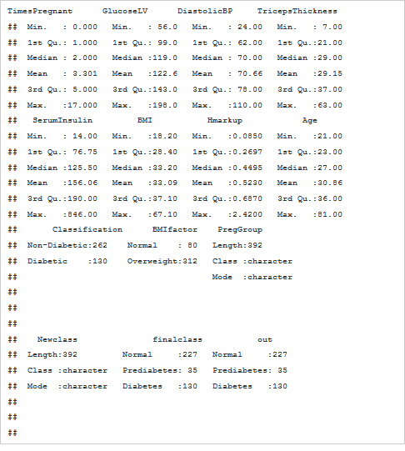
Summary of Data with creation of additional classification variable.
Three Outcome-Diabetes, Pre-Diabetes & normal
from existing dataset
Two Outcomes- Diabetes & Non Diabetes
Those patients with Glucose between 140 and 200 in Fasting have been identified as Prediabetic

Slide 6
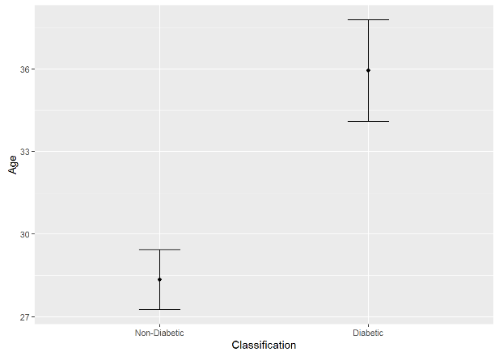
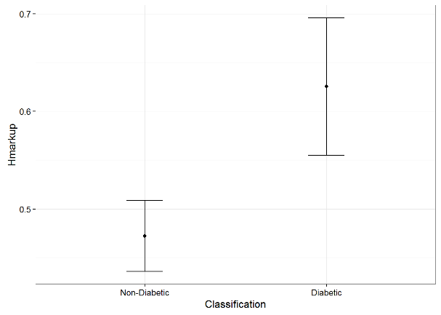
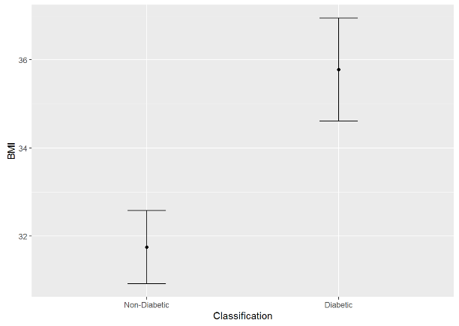
Exploratory Analysis showing BMI, Age & H mark up is significantly higher in Diabetic than non diabetic group
Non Diabetic
Diabetic
Non Diabetic
Diabetic
Non Diabetic
Diabetic

Slide 7
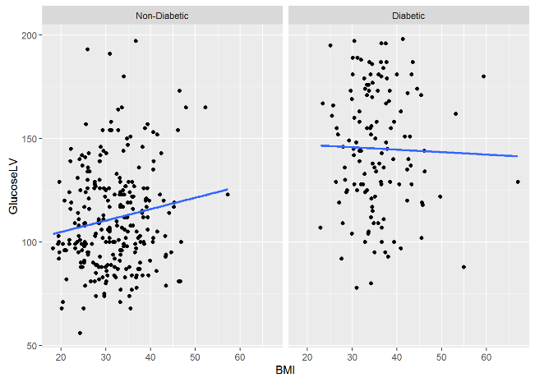
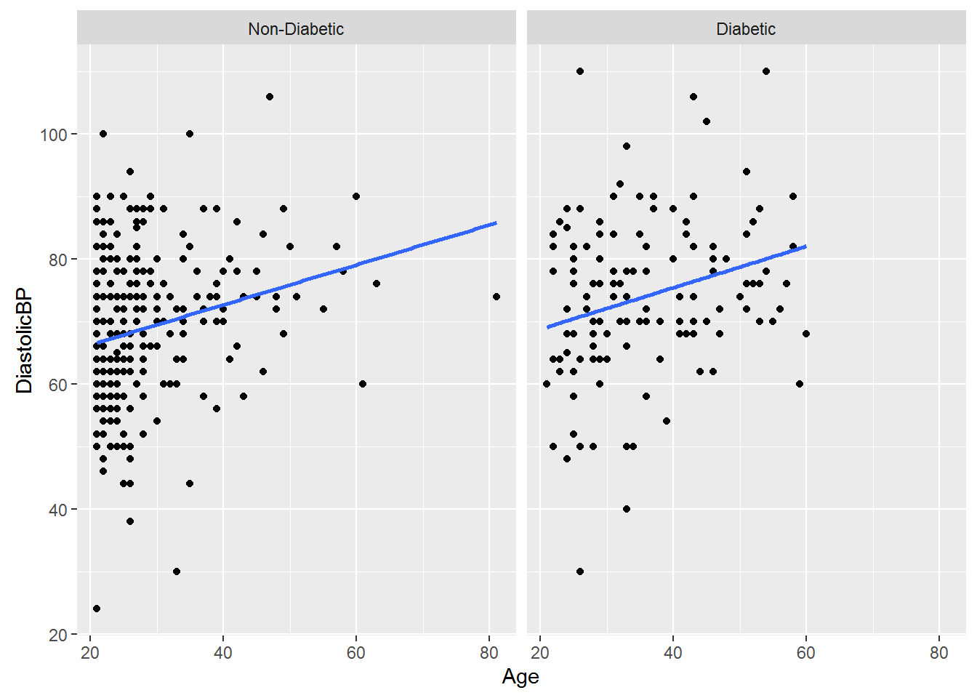
Interaction of different Dependent variable- Glucose increases with BMI in Non Diabetic population while diastolic BP increases with age across both the groups
Non Diabetic
Diabetic
Non Diabetic
Diabetic

Slide 8
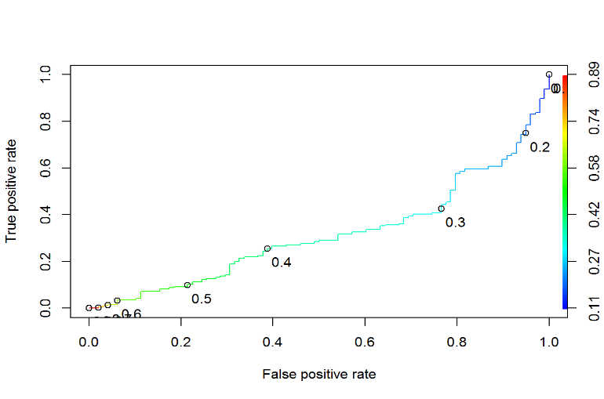
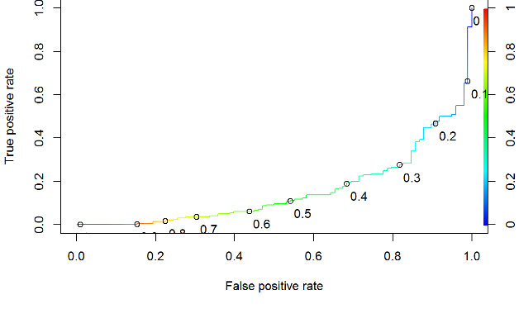
ROC curves were generated for different models to predict Diabetes using Train Dataset
Model 1- ROC curve for Predicting Diabetes based on Factor BMI( as factor variable ) and continuous variables like Triceps Thickness and Age
Model 2-Continous Variable ,TT,Diastolic BP, Age,BMI

Slide 9
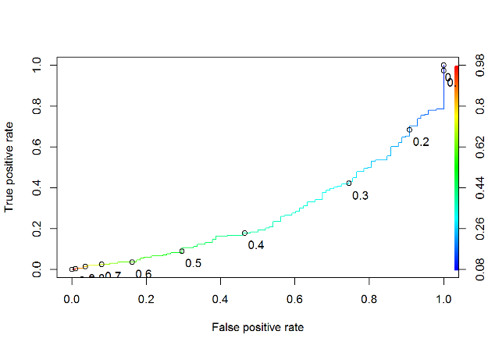
ROC curve for Model 3- the best model with highest sensitivity & moderate specificity at 0.16
Model 3- Prediction of Diabetes using continuous variable which includes- Hmarkup,Age,Triceps Thickness ,Diastolic Pressure,Age, BMI

Slide 10
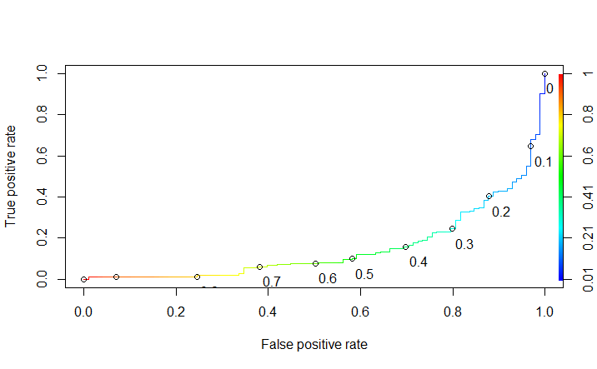
ROC curves for Model 4 and Model 5 while considering interaction between variables
Model 5: All parameters in 4 excluding Diastolic BP and include their interactions
Model 4- All Parameters of Model 3 +Interactions

Slide 11
Model7 –Prediction of Diabetes, Pre-Diabetes & Normal while using Multinomial Logistic Regression
Actual | Predicted Normal | Predicted Pre-Diabetes | Predicted Diabetes
Normal | 198 | 0 | 29
PreDiabetes | 21 | 0 | 14
Diabetes | 29 | 0 | 65
14 Pre-diabetics patients are suspected to be Diabetes. These are high focus patients to bring more rigorous Lifestyle changes to prevent and improve their conditions to prevent Diabetes

Slide 12
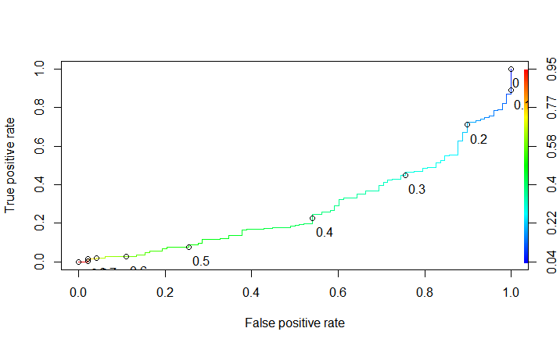
Hypothesis Testing/Validation testing for
Model #3 on test data set
Actual Outcome | Predicted No Diabetes /False | Predicted Diabetes /True
No Diabetes | 18 | 48
Diabetes | 0 | 32
After running model 3 on test data and with t value around 0.15 –we find the model has high sensitivity
and low- moderate specificity- We are able to identify all True Positives with some false Negative 18 patients can be
Considered as healthy and they can be asked to pay low insurance premiums

Slide 13
Recommendation
Insurance Companies could use the model 3 with t value 0.15 to identify patients who should have low insurance premium/least suspected patients. This is because the model has highest Sensitivity with a modest specificity as compared to other models. Hence the model will identify subject with less false positive without impacting any True Negative.
Hospitals and health Care companies who wants to target new Diabetic Medicine for high risk group or new Diabetic Campaigns should ensure that campaigns should not target False Positives . They should target patients with critical care and risk. Hence they should use Model 6 with t=0.4 to target definite & High Risk Diabetic patients. This is because model 6 identifies low false positive and hence will identify the worst patients in True Positive group. This is because worst /critical diabetes patients based on this model will help in finding patients who have any significant impact on existing pharmacological treatment
Model 7 is recommended to be used by Healthcare Agencies to identify schemes/plan for Suspects. (Pre-Diabetics who are suspected to be Diabetics). This is because this model identifies Pre-Diabetics which have biological markups similar to Diabetic Patients and hence are high risk suspects

